Slide 1
UNDERSTANDING
& MANAGING STRESS
Recognise it • Understand it • Respond to it
Health & wellbeing | ReachOut Australia / ReachOut Schools
1

Slide 2
Learning intention
By the end of the lesson, you should be able to:
Understand what stress is and how it affects you as an individual.
RECOGNISE
UNDERSTAND
RESPOND
Explain when stress can help and when it can become unhelpful.
Identify physical, emotional and behavioural signs of stress.
Identify strategies to manage stress and seek support.
You do not need to share personal experiences during this lesson.
2

Slide 3
What is stress?
Stress is a normal part of life.
Stress is the body’s response to a challenge or situation that requires us to respond.
SOME STRESS CAN HELP
It can increase focus, alertness, energy and motivation.
STRESS CAN ALSO WORK AGAINST US
If it is too intense, happens too often or lasts too long, it can affect wellbeing.
The goal is not to eliminate all stress — it is to recognise and manage it.
3

Slide 4
Activity 1: Stress brainstorm
5–10 minutes | Post-it notes
Write one word or short phrase on each note.
THINGS I CAN CONTROL
What does stress feel like?
What causes stress?
Where does pressure come from?
What might someone do when stressed?
What situations create pressure for teenagers?
Preparation • time management • asking for help • my response
THINGS I CAN’T ALWAYS CONTROL
Other people’s behaviour • unexpected events • past mistakes • some outcomes
Place your notes in the control circles on the board. You can keep examples general.
4

Slide 5
The stress bell curve
People experience stress differently.
TOO LITTLE STRESS
A HELPFUL AMOUNT
TOO MUCH STRESS
• Bored
• Unmotivated
• Disengaged
• Not performing at your best
• Focused
• Alert
• Motivated
• Ready to respond
• Able to perform
• Overwhelmed
• Anxious
• Hard to concentrate
• Exhausted
• Poor sleep
• Feeling unable to cope
A small amount of stress can help performance. Too much can make performance harder.
5

Slide 6
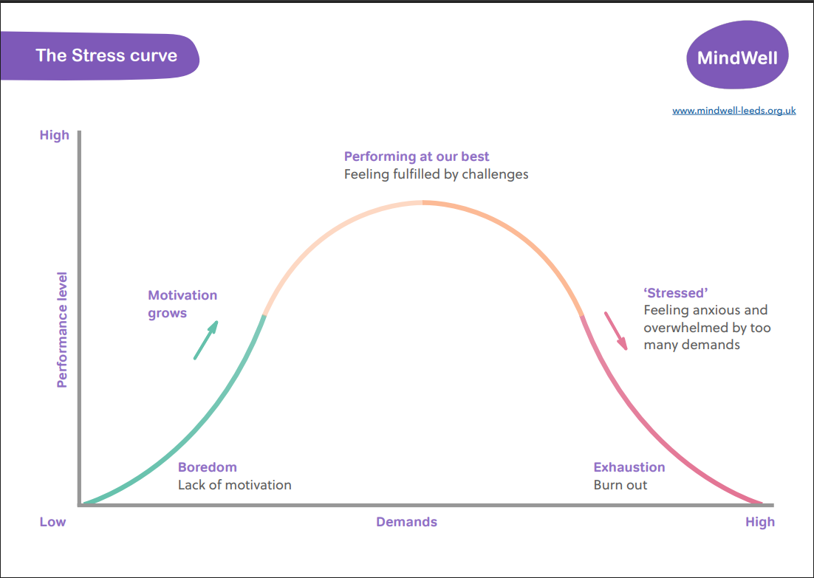

Slide 7
Think about it
Pair discussion — you can use an example from sport, school or everyday life.
When might a small amount of stress help someone perform better?
Preparing for a test
Playing sport
Performing on stage
Speaking in front of the class
Completing a project
DISCUSS
What might change if the stress became too intense or lasted too long?
6

Slide 8
Recognising stress overload
Stress can affect us physically, emotionally and behaviourally.
PHYSICAL
EMOTIONAL
BEHAVIOURAL
• Headaches or muscle tension
• Upset stomach or nausea
• Difficulty sleeping
• Feeling shaky or exhausted
• Getting sick more often
• Feeling overwhelmed
• Nervousness or anxiety
• Irritability or mood changes
• Feeling down
• Negative thoughts
• Difficulty relaxing
• Withdrawing from friends/family
• Avoiding responsibilities
• Forgetfulness or poor concentration
• Nail biting or fidgeting
• Losing interest in usual activities
Recognising signs early gives you a chance to respond before stress becomes harder to manage.
7

Slide 9
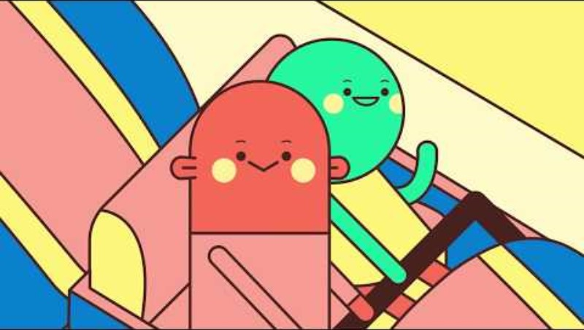
Video: The Ups and Downs of Stress
8

Slide 10
What does stress do to the body?
The body releases stress hormones to prepare us to respond to a challenge.
BRAIN & NERVOUS SYSTEM
HEART & BREATHING
DIGESTIVE SYSTEM
More alert; ongoing stress can mean worry, headaches and difficulty switching off.
Faster heartbeat and breathing; blood pressure may rise.
Upset stomach, nausea and digestive discomfort.
MUSCLES
IMMUNE SYSTEM
SKIN, HAIR & SEXUAL HEALTH
Tension can contribute to neck, shoulder and back pain, headaches and body aches.
Ongoing stress can affect immune function and recovery.
Stress can contribute to skin changes, hair loss in some circumstances, and reduced sexual desire.
Stress is designed to be a short-term response, not a constant state.
9

Slide 11
What can I control?
Focus your energy on what you can influence or change.
THINGS I CAN CONTROL
THINGS I CAN’T ALWAYS CONTROL
• How I prepare
• How I organise my time
• Whether I ask for help
• How I respond
• How I look after myself
• The actions and choices I make
• Other people’s behaviour or opinions
• Unexpected events
• What has already happened
• Some outcomes
• Things happening around me
I can’t always control what happens, but I can often control how I respond.
10

Slide 12
Problem-solving: 8 steps
Use this process when there is something you can do about the situation.
1. Define
2. Set a goal
What exactly is the problem?
What would you like to happen?
3. Brainstorm
4. Rule out
List possible solutions.
Remove unrealistic or unhelpful options.
5. Consider
6. Choose
Think through the pros and cons.
Select a practical, helpful option.
7. Try it
8. Review
Put the solution into practice.
Did it work? If not, try another approach.
Example: Three assignments are due in the same week. List deadlines, break tasks down, plan the order and ask for help if needed.
11

Slide 13
Have a go: make a problem manageable
Work with a partner or think through the example independently.
Scenario: You have three assignments due in the same week.
What is the specific problem?
What is one realistic goal?
List three possible actions.
Which action would you try first?
How would you review whether it helped?
REMEMBER
You do not need to solve everything at once. Start with one manageable step.
12

Slide 14
When I can’t control the situation
Sometimes there is no solution that can change what has happened.
Acceptance means recognising what is happening and focusing on what you can do next.
ACCEPTANCE IS NOT…
TREAT YOURSELF KINDLY
NOTICE YOUR THOUGHTS
• Agreeing with it
• Thinking it is fair
• Liking it
• Giving up
What would you say to a friend in the same situation?
Thoughts are not always facts. Try: “I just had the thought that…”
Talking to a trusted person can also help you feel less alone and put things in perspective.
13

Slide 15
Managing exam stress: before the exam
Small practical steps can reduce unnecessary pressure.
PREPARE
LOOK AFTER YOURSELF
• Prepare rather than cram
• Organise your equipment
• Manage your time
• Break work into smaller tasks
• Take regular breaks
• Get enough sleep
• Eat and drink appropriately
• Use breathing or mindfulness
• Use positive self-talk
• Ask for help if you need it
Aim for steady preparation, not last-minute perfection.
14

Slide 16
Managing exam stress: during the exam
If you feel overwhelmed, focus on the next manageable step.
1. Pause and breathe
Take a slow breath in through your nose and gently breathe out.
2. Read instructions
Check what each question is asking.
3. Be your own coach
“I can work through this one question at a time.”
4. Take a micro-break
If permitted, stretch or take a sip of water.
5. Move on
If stuck, move on and return later if time allows.
15

Slide 17
Looking after yourself
There is no single strategy that works for everyone.
Get enough sleep
Move your body regularly
Take breaks and do things you enjoy
Practise breathing or mindfulness
Stay connected with friends and family
Organise your time and break up big tasks
Talk to someone you trust
ASK FOR SUPPORT
If stress is ongoing, overwhelming or affecting everyday life, talk with a trusted adult or health professional.
You don’t have to manage everything alone.
16

Slide 18
Reflection: one next step
You can keep your response private — you do not need to share it with the class.
Think about a common source of stress for students (for example, deadlines or exams).
What part of the situation might be within someone’s control?
What is one practical step they could take?
If it is outside their control, what might help them cope?
Who could they talk to if the stress became overwhelming?
Key message: Recognise stress early, focus on what you can influence, and seek support when needed.
17

Slide 19
Sources and support
Based on ReachOut Australia / ReachOut Schools resources.
What is stress? https://schools.au.reachout.com/study-stress/what-is-stress
What does stress do to the body? https://au.reachout.com/articles/what-does-stress-do-to-the-body
A step-by-step guide to problem solving: https://au.reachout.com/articles/a-step-by-step-guide-to-problem-solving
How acceptance can help you cope with things out of your control: https://au.reachout.com/articles/how-acceptance-can-help-you-cope-with-things-out-of-your-control
The Ups and Downs of Stress video: https://www.youtube.com/watch?v=wYOghh03qQ4
NEED SUPPORT?
Speak with a trusted adult, parent/carer, teacher, school wellbeing staff member or health professional.
18

